Slide 1
Machine Learning
Machine Learning Introduction

Slide 2
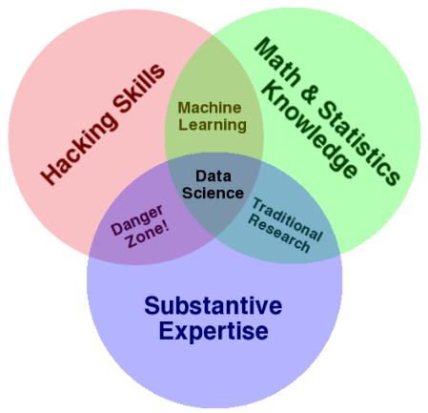

Machine Learning Introduction
Machine learning is a field of computer science that gives computer systems the ability to "learn" with data, without being explicitly programmed. The name Machine learning was coined in 1959 by Arthur Samuel.

Slide 3
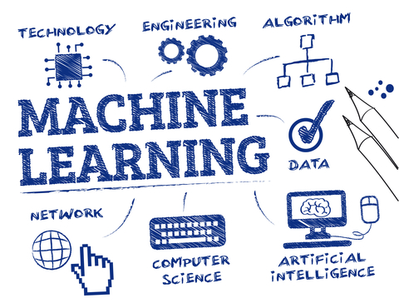
Machine Learning Introduction
ML is a system which can do automatic acquisition and integration of knowledge.
It is that branch of artificial intelligence that deals with the construction of systems that can learn from data
Develop methods that can automatically detect patterns in data, and then to use these patterns to predict future data
Machine learning can predict
the future based on the past
Computer programs that
automatically improve their
performance through experience

Slide 4
Why Machine Learning?
Automatically adapt and customize to individual users.
Personalized news, mail filters, movie/book recommendation
Discover new knowledge from huge amount of data
Market analysis
Perform repetitive monotonous tasks of humans which require intelligence and experience
Recognize signatures or handwritten characters
Driving a car, flying a plane
Rapidly changing phenomenon
Credit scoring, financial modeling, diagnosis, fraud detection
No human experts industrial/manufacturing control, mass spectrometer analysis, drug design

Slide 5
Machine Learning
Concepts & Dimensions of Machine Learning

Slide 6
Concepts of Learning
Learning = Improve Task “T” with respect to performance measure “P” based on experience “E”
Example: Spam Filtering
T: Identify Spam emails
P: % of Spam emails filtered correctly, % of non-Spam emails that were filtered incorrectly (false positives)
E: Database of emails labelled manually by users
A checkers learning problem:
Task T: playing checkers
Performance measure P: percent of games won against opponents
Training experience E: playing practice games against itself
We can specify many learning problems in this fashion, such as learning to recognize handwritten words, or learning to drive a robotic automobile autonomously

Slide 7
Concepts of Learning
Example: Signature matching
T: Determine if signature belongs to correct person
P: % of signatures that were correctly matched, % of valid signatures that were incorrectly labelled as not matching
E: Database of signatures known to be of that person

Slide 8
Dimensions Of Learning Systems
What is Dimension of Learning?
Dimensions of Learning is a comprehensive model that uses what researchers and theorists know about learning to define the learning process. There are five types of thinking – what we call the five dimensions of learning- are essential to successful learning.
Dimension 1: Attitudes and Perceptions
Attitudes and perceptions affect students’ abilities to learn. For example, if students view the classroom as an unsafe and disorderly place, they will likely learn little there.

Slide 9
Dimensions Of Learning Systems
Dimension 2: Acquire and Integrate Knowledge
When students are learning new information, they must be guided in relating the new knowledge to what they already know, organising that information, and then making it part of their long-term memory.
Dimension 3: Extend and Refine Knowledge
Learning does not stop with acquiring and integrating knowledge. Learners develop in-depth understanding through the process of extending and refining their knowledge

Slide 10
Dimensions Of Learning Systems
Dimension 4: Use Knowledge Meaningfully
The most effective learning occurs when we use knowledge to perform meaningful tasks. For example, we might initially learn about tennis rackets by talking to a friend or reading a magazine article about them.
Dimension 5: Habits of Mind
The most effective learners have developed powerful habits of mind that enable them to think critically, think creatively, and regulate their behaviour.

Slide 11
Machine Learning
The Learning Process

Slide 12
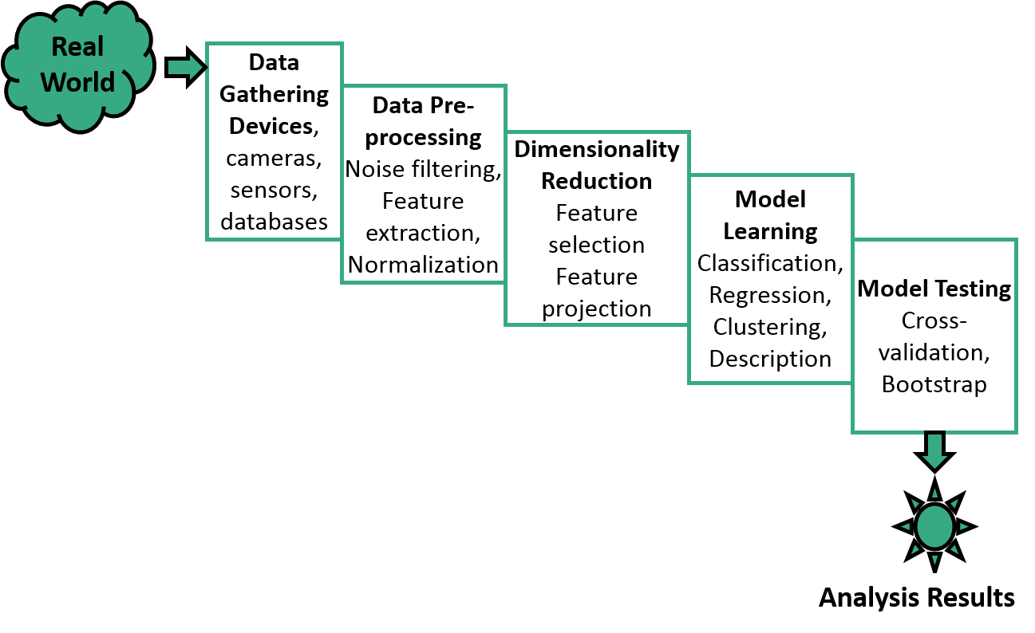
The learning Process

Slide 13
The learning Process
Bootstrap aggregating, also called bagging, is a machine learning ensemble meta-algorithm designed to improve the stability and accuracy of machine learning algorithms used in statistical classification and regression.

Slide 14
Machine Learning Steps
Training Data
(past)
Learn
Model
Testing Data
(future)
Model
Predict
Steps:
Gather Data from various sources
Clean data to have homogeneity
Build model (select the right Machine Learning algorithm)
Gather insights from the model’s results
Visualize – transform results into visual graphs

Slide 15
Performance Evaluation
Randomly split examples into training set U and also test set V.
Use training set to learn a hypothesis H.
Measure % of V correctly classified by H.
Repeat for different random splits and average results.

Slide 16
Problems - Overfitting & Underfitting
Overfitting – the model learns the training set too well. It overfits to the training set and performs poorly on the test set
Underfitting – when the model is too simple, both training and test errors are large

Slide 17
Machine Learning
Categorization of Machine Learning

Slide 18
Categorization of Machine Learning
Machine Learning
Supervised
Unsupervised
Reinforcement
Task Driven, labelled (Regression/Classification).
Input variables X and output variable Y. Y = f(X).
Algorithm learns from training data set. Iteratively make predictions which are corrected (teaching).
Learning stops when performance reaches acceptable level.
Data Driven, unlabeled (Clustering)
No correct answers, no teacher, no labelling
Algorithm looks for patterns in data.
Reward feedback based
Algorithm learns to react to an environment. Automatically determine ideal behavior within a context.

Slide 19
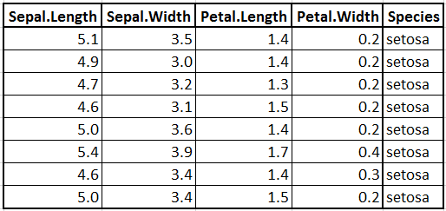

Data Set for Supervised Learning

Slide 20
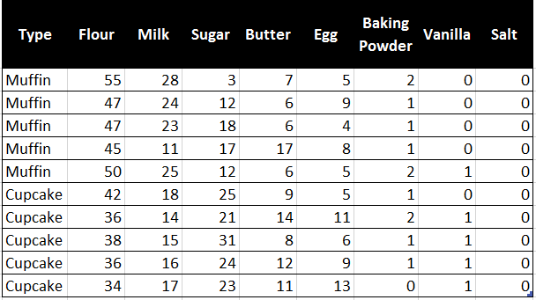


Data Set for Supervised Learning

Slide 21
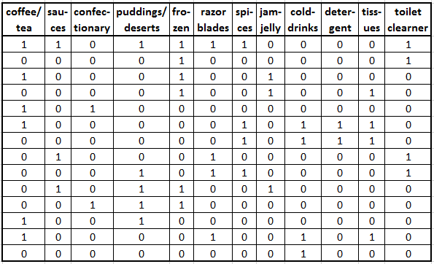
Data Set for Unsupervised Learning

Slide 22
Machine Learning Coordinates
Supervised Learning
Unsupervised Learning
Classification or Categorization
Clustering
Discrete
Regression
Dimensionality Reduction
Continuous

Slide 23
Machine Learning Coordinates
Supervised Learning
Unsupervised Learning
Classification or Categorization
Clustering
Discrete
Regression
Dimensionality Reduction
Continuous
In statistics, machine learning, and information theory, dimensionality reduction or dimension reduction is the process of reducing the number of random variables under consideration by obtaining a set of principal variables. It can be divided into feature selection and feature extraction

Slide 24
Classification & Clustering
Classification is the problem of identifying to which of a set of categories (classes) a new observation belongs, on the basis of a training set of data containing observations (or instances) whose category membership is known.
Classification is considered an instance of supervised learning, i.e. learning where a training set of correctly identified observations is available.
The corresponding unsupervised procedure is known as clustering, and involves grouping data into categories based on a measure of similarity or distance.

Slide 25
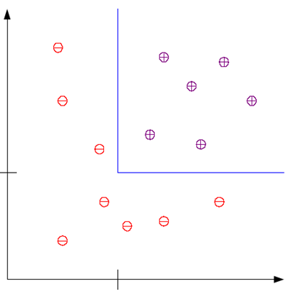


Classification & Clustering
Example: This is an example of a classification problem where there are two classes: low-risk and high-risk customers. The information about a customer makes up the input to the classifier whose task is to assign the input to one of the two classes. After training with the past data, a classification rule learned may be of the form
Low-Risk
Savings
IF Income > Ѳ1 AND Savings > Ѳ2 THEN
Low-Risk
ELSE
High-Risk
$$θ_{2}$$
High-Risk
$$θ_{1}$$
Income

Slide 26
Regression
A regression problem is when the output variable is a real value, such as “dollars” or “weight” instead of a class.
Estimate the relationship between a dependent variable and one or more independent variables (or 'predictors’)
Sales figures for a television model can depend on several factors like screen size, display type, brand, resolution, technology etc.
Here, we consider just one attribute, screen size and plot the corresponding prices
x: screen size
y: sales figures
We try to find the relation (function) that best matches these values
x
y‘ = w₀ + w₁x₁
x
x
x
x
y: sales figures
x
x
x
X: screen size

Slide 27
Dimensionality Reduction
Dimensionality reduction is the process of reducing the number of random variables under consideration by obtaining a set of principal variables. It can be divided into feature selection and feature extraction.
Feature selection approaches try to find a subset of the original variables (also called features or attributes). It is about choosing some of features based on some statistical score.
Feature extraction transforms the data in the high-dimensional space to a space of fewer dimensions. It is using techniques to extract some second layer information from the data e.g. interesting frequencies of a signal using Fourier transform.
Dimensionality reduction helps in data compression, reduces computation time and removes redundant features.

Slide 28
Machine Learning
Machine Learning Applications

Slide 29
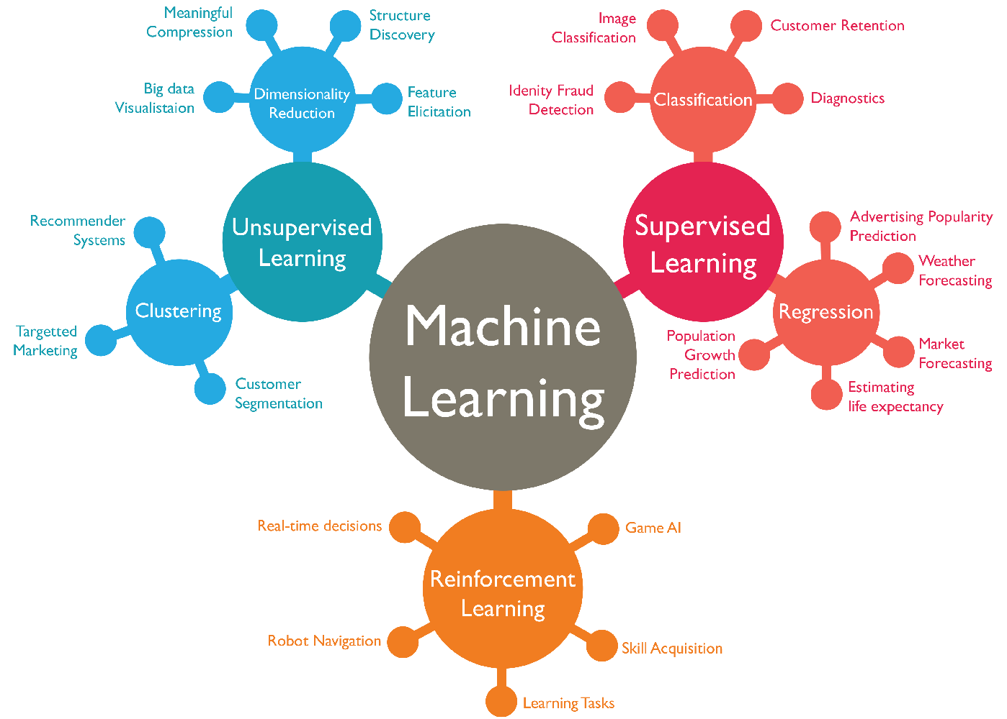
Applications of Machine Learning

